Slide 1

Hill climbing AI PROJECT
Kaniksha sharma
A023119819013
4CSE-13X

Slide 2
Steepest-Ascent hill climbing:
The steepest-Ascent algorithm is a variation of simple hill climbing algorithm. This algorithm examines all the near nodes of the current state and selects one near node which is closest to the goal state. This algorithm consumes more time as it searches for multiple near nodes.

Slide 3

main features of Hill Climbing Algorithm
Generate and Test variant: Hill Climbing is the variant of Generate and Test method. The Generate and Test method produce feedback which helps to decide which direction to move in the search space.
Greedy approach: Hill-climbing algorithm search moves in the direction which optimizes the cost.
No backtracking: It does not backtrack the search space, as it does not remember the previous states.

Slide 4

Pizza delivery problem:-

Slide 5
problem space:-
There’s pizza delivery boy who needs to visit 4 location exactly ones, after which he must return to the location from where he started.
The distance btw each pair of location is known.
Conditions:- 1. visit all the locations , 2. visited only once, 3. reach where started.
To find :- shortest
Route possible.
State space:-
0
200
1
300
100
100
3
2
200

Slide 6
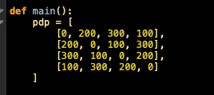
Representing the problem space in python:-

Slide 7
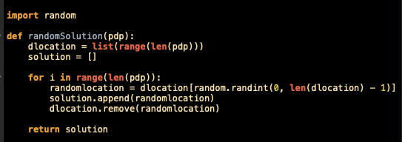
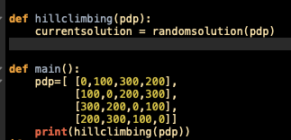
Step1:- generate a random solution

Slide 8
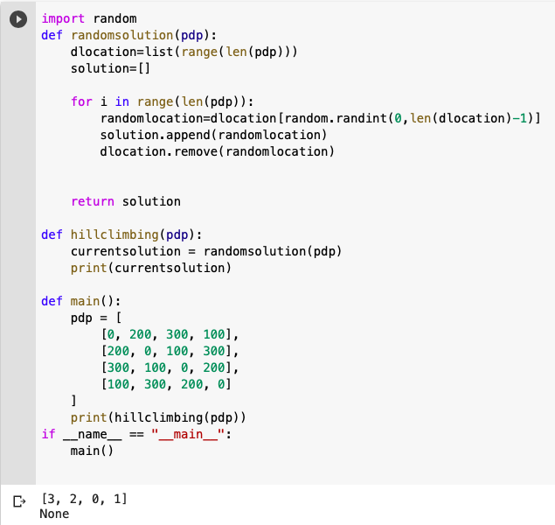

Slide 9
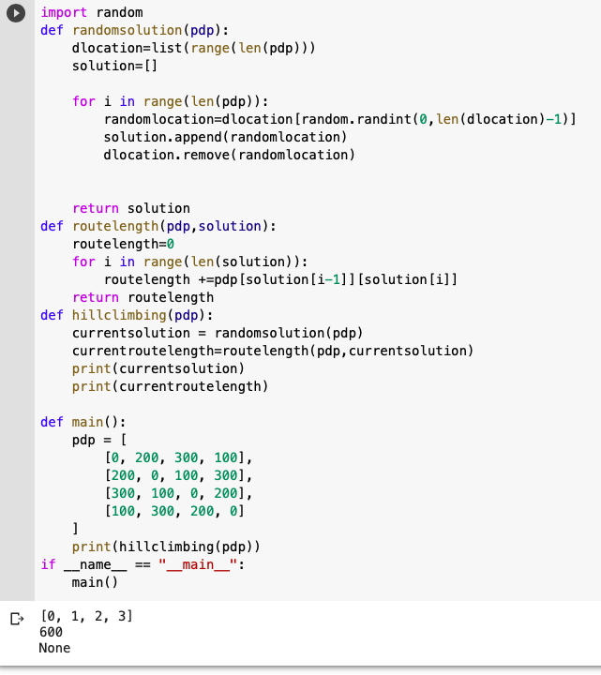

Slide 10
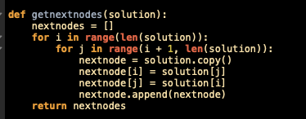
Generating all the near possible solutions/nodes

Slide 11
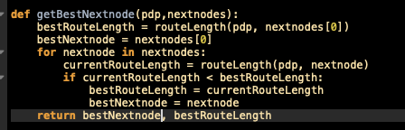
Selecting the best solution from all the solutions

Slide 12
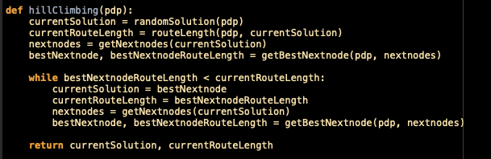
Finally creating hill climbing algorithum

Slide 13
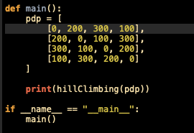
Time to run

Slide 14

output

